Slide 1
Lesson Overview
Stop and think- see what students already know about simulations 3 mins
Simulation in MEME- what is a simulation and how to make it run 20 mins
Revise models- in groups students will revise models in MEME 10 mins
Reading the graphs- how to read the graphs in MEME 15 mins
Before you go- review what students learned from the simulation 2 mins
Total time- 50 mins

Slide 2
STOP & THINK!
Grab handout 2 and put your name and information on the top of the first page.
Complete the STOP & THINK! question on the first page.
Have you ever heard the word “simulation”?
What do you think a simulation is?
Notes:
3 min-- This stop and think will come in the middle of a lesson, since we are continuing this after we complete the last lesson
Have students fill out their details (name, class and date) then answer the Stop & Think question on their handout
Do not hold a class discussion at this point. Just let them do the STOP & THINK, maybe solicit a few answers by asking a couple of students to share but keep this brief and quickly and move on.

Slide 3
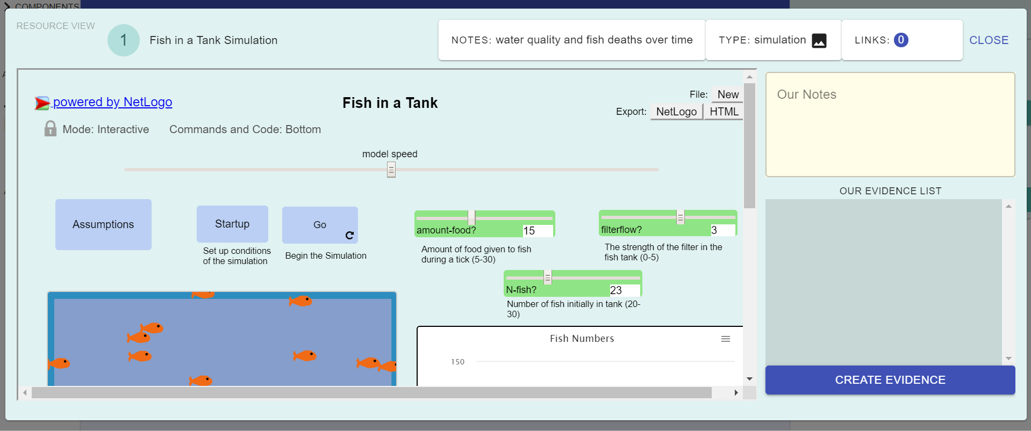
New in MEME: Simulations!
We have a new kind of resource in our library today! A simulation!
Notes:
Tell them that now we will try something new- simulations!
Then move to next slide for a brief discussion

Slide 4
New in MEME: Simulations!
What are simulations?
How can simulations help us understand what is happening to the fish?
Do scientists use simulations too?
Notes:
5 min---Ask them– what do they think a simulation is and how it can help them solve the fish mystery?
Do scientists use simulations? Keep this brief and just get ideas out. No need to correct them just surface.

Slide 5
What’s in the simulation? How can we make it run?
Notes:
This is a very brief introduction to simulations. Just gives the basics of what they can do. Go over the next few slides and then let them work with the simulation

Slide 6
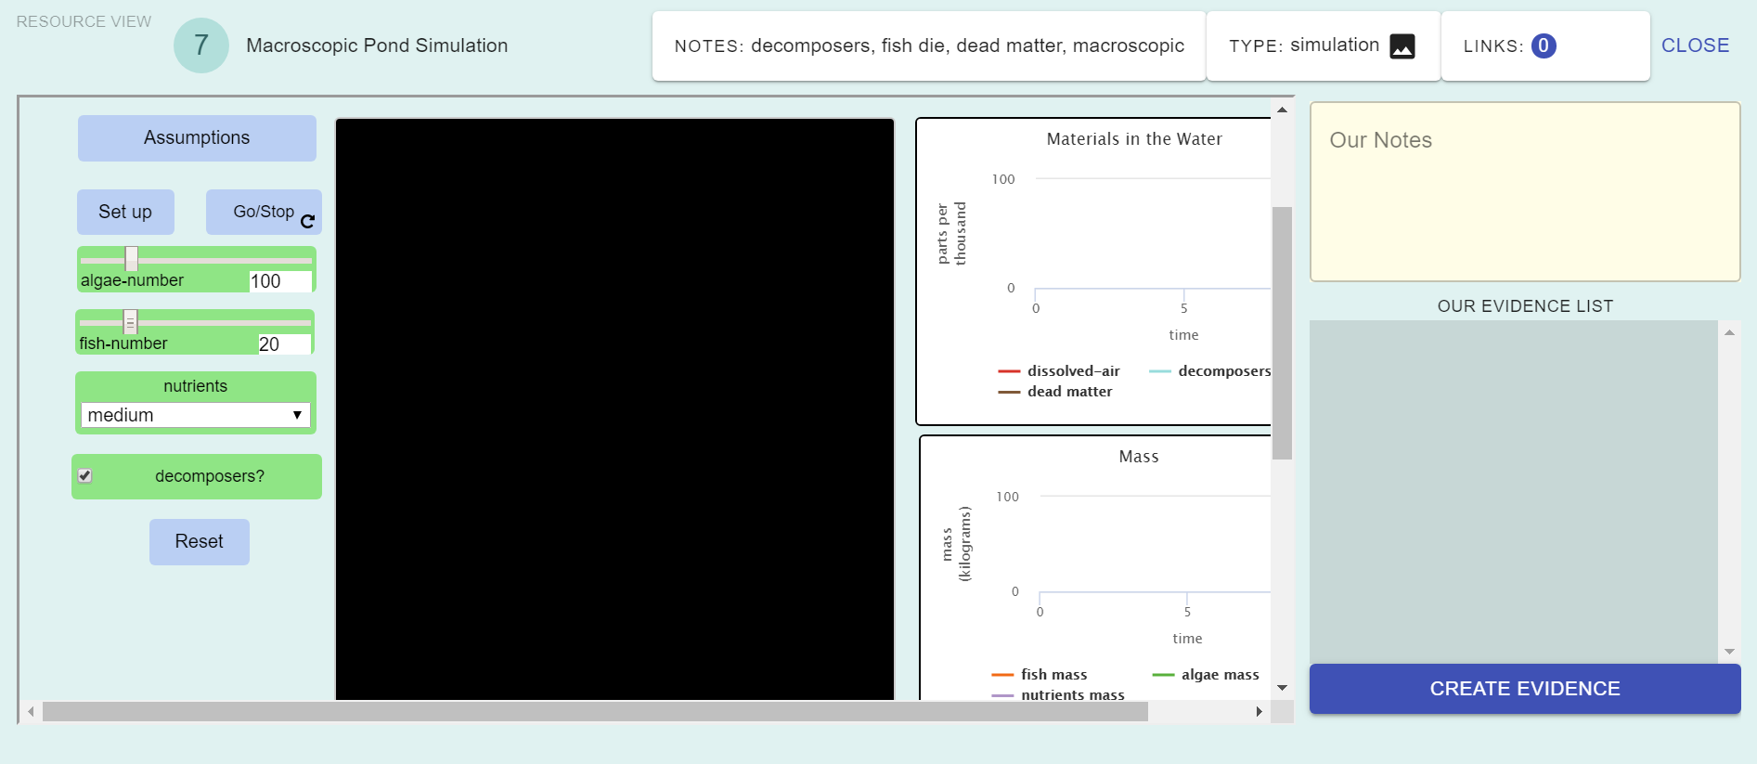
What’s in the simulation?
If you want to learn some things about the simulations, you can click “Assumptions”

Slide 7
What’s in the simulation?
You can try running the simulation with lots of different conditions. You can change all of the green boxes.

Slide 8
What’s in the simulation?
Make sure that after you make all of your changes, you click “Set Up”

Slide 9
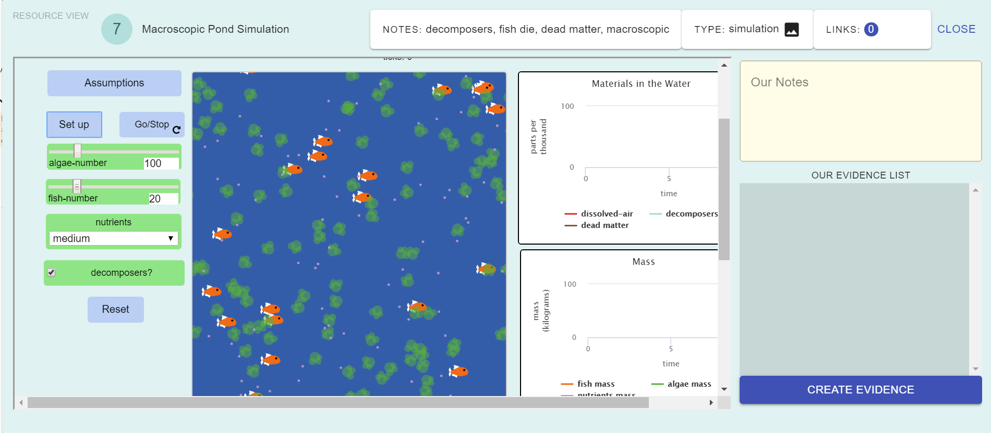
What’s in the simulation?
Then it will look more like a pond!
After, you can press “Go/Stop” to run the simulation (or stop it!)

Slide 10
Try it out!
Work in groups with the simulation and revise your models if you need to
Remember to answer the questions on page 1 of handout 2!
Notes:
10 min---In their small groups/pairs, students can try the simulations out.
Then we will pull them together and discuss

Slide 11
Revise Your Model
Based on the resources (studies and simulation), do you need to change your model?
Remember to link the evidence to parts of your model!
Notes:
In their small groups/pairs, students revise their MEME models based on the new resources.
Remind them to link the evidence to the model.
Walk around and see what students find challenging. Based on that, stop the students and guide them. There are slides to help guide you if necessary.

Slide 12
Reading the Graphs
Notes:
How to read the graphs– if students struggle with graphs you can stop their work and go over the next few slides
Note that students may eb OK with the graphs, this set of slides is optional depending on need.
Its best to let them struggle a bit first before helping them, so don’t go over these before students have had a chance to play with the sim

Slide 13
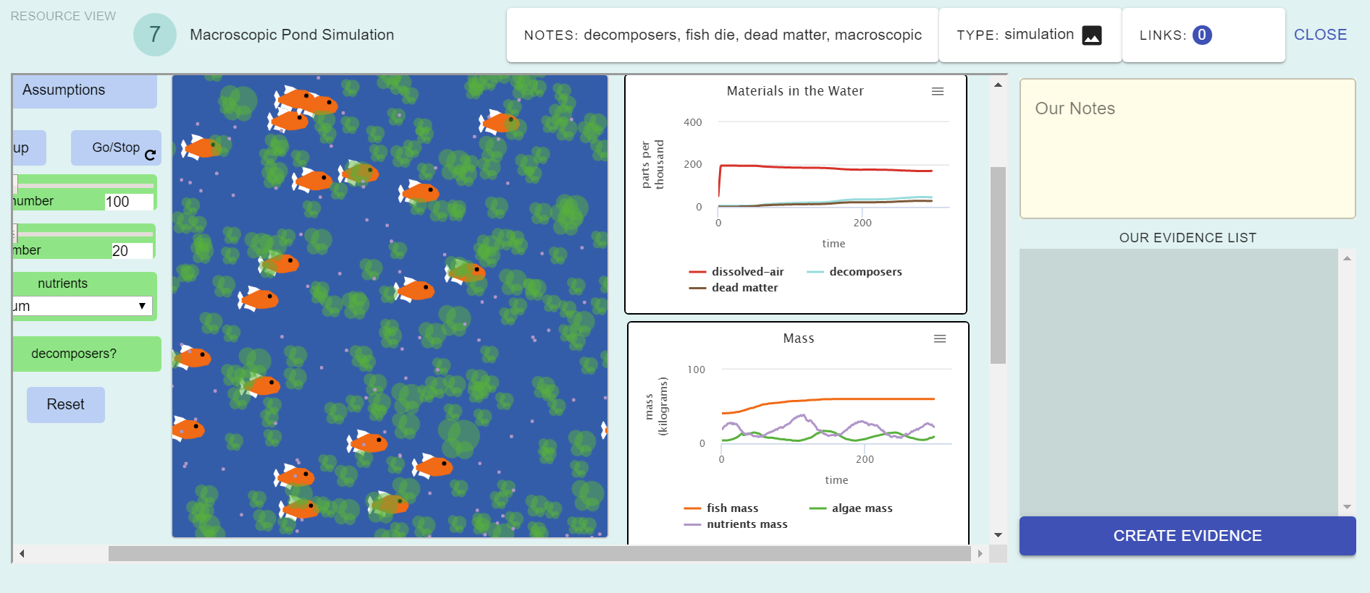
Graphs in MEME
In this simulation, there are two graphs.
The graphs help you understand what’s happening in the pond.

Slide 14
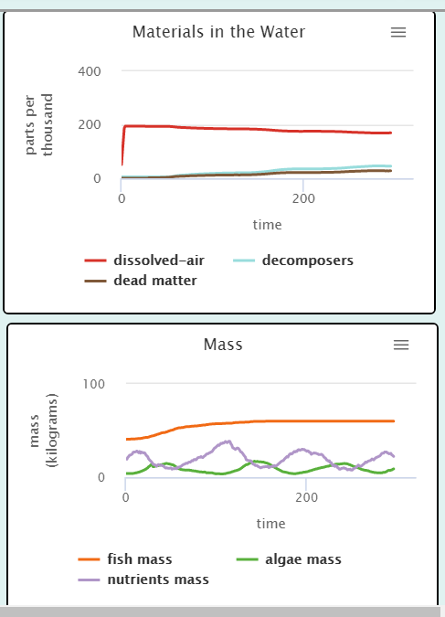
Reading the Graphs
What is the top graph about? (Hint: Look at the title!)
What are the lines on the graph?
How are the lines measured? (Hint: Look at circled axes!)
Notes:
The graph is measuring the amount of dissolved air, decomposers, and dead matter over time.

Slide 15
Reading the Graphs
Go back to the simulation.
In the sliders, set Algae to 100 Fish number to 20 Nutrients to “Medium” Decomposers = on (checked)
Hit “Set Up”, then “Run”. What happened to the top graph?
Notes:
The graph is measuring the amount of dissolved air, decomposers, and dead matter over time.

Slide 16
Reading the Graphs
What is the top graph about? (Hint: Look at the title!)
What are the lines on the graph?
How are the lines measured? (Hint: Look at circled axes!)
Notes:
The graph is measuring the mass of the fish, nutrients, and algae over time.

Slide 17
Reading the Graphs
Go back to the simulation.
In the sliders, set Algae to 100 Fish number to 20 Nutrients to “Medium” Decomposers = on (checked)
Hit “Set Up”, then “Run”. What happened to the top graph?
Notes:
The graph is measuring the mass of the fish, nutrients, and algae over time.

Slide 18

Simulation Discussion
What did you notice?
What do you wonder about?
Notes:
7min ---Pull the class together for a brief discussion before the end of class. Have them share some things they noticed and wonder about the simulation and how these relate to the fish mystery
Tell them that they will have more time with the simulation next time

Slide 19
BEFORE YOU GO
Complete the BEFORE YOU GO questions.
What is one thing that you learned from the simulation?
Notes:
3min-- Use this “Before You Go” as an exit ticket.

Slide 20
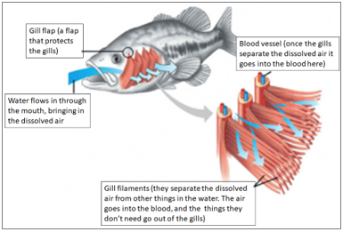
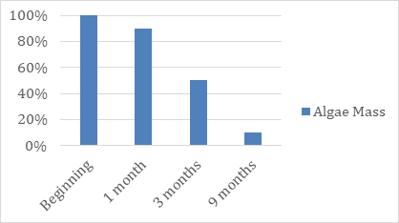
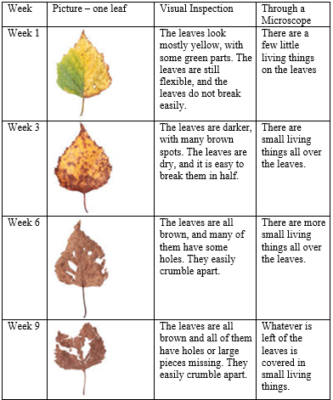
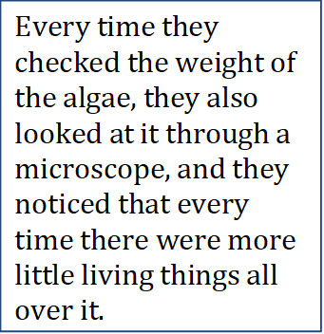
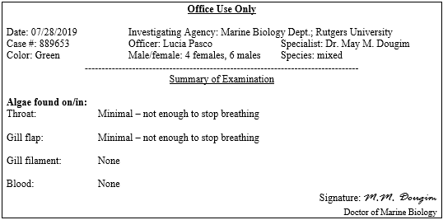
Let’s use evidence to figure out why the fish are suffocating.
Discuss ALL the evidence pieces in pairs and answer the questions individually.
Evidence 1
Evidence 2
Evidence 3

Slide 21
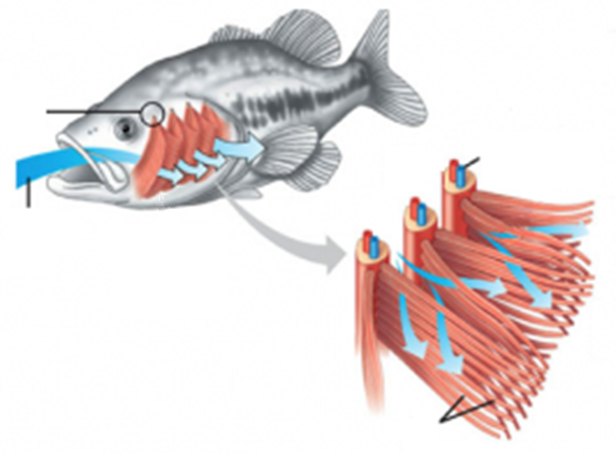
Gill flap – a flap that protects the gills
Blood vessel – once the gills separate the dissolved air it goes into the blood here
Water flows in through the mouth, bringing in the dissolved air
Gill filaments – separate the dissolved air from other substances in the water.
Notes:
Evidence 1 part 1

Slide 22
Notes:
Evidence 1 part 2

Slide 23
Notes:
Evidence 2

Slide 24
Notes:
Evidence 3

